Slide 1
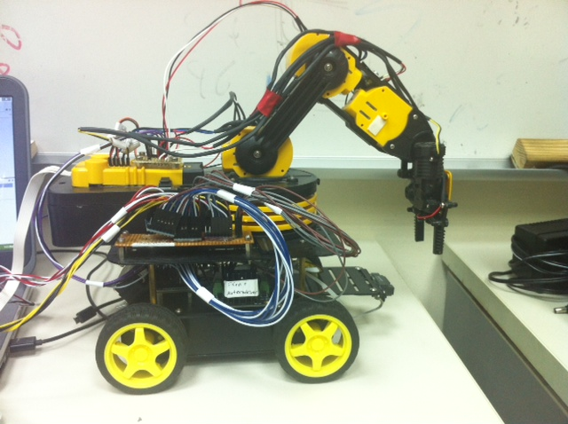
Autonomous Tower Builder Robot
Doron Atuar
Hagar Tal
Pavel Rubinson
Tom Rashman
Advisor: Prof. Ronen Brafman

Slide 2
Main Goal
Build a robot that can autonomously construct a cube tower from colored cubes, by a specified order.

Slide 3
Presentation Outline:
Main technical challenges.
Hardware:
Parts and electronics.
Robot control.
Software:
Remote-Control app and movement API.
Main App:
Architecture outline.
Object detection & image processing.
Arm movement.
Main control loop.
Final words.

Slide 4
Main Technical Challenges
Electronics and mechanical engineering aspects.
Working with new platforms (Android, IOIO interface, OpenCV)
Building an API for interacting with the robot.
Motion planning.
Object Detection.
Connecting everything together.
Notes:
Electronics - assemble everything without damaging the hardware, soldering etc. monitoring the arm’s joint position. Making decisions on how to assemble the robot.
Motion planning – how to move in the space that we are in.

Slide 5
Hardware

Slide 6
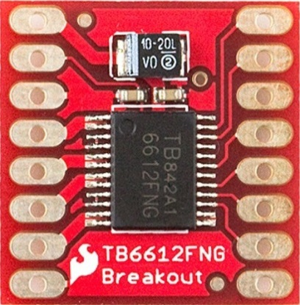
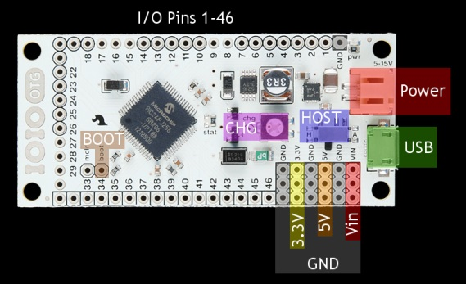
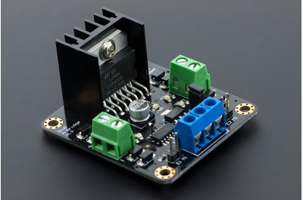
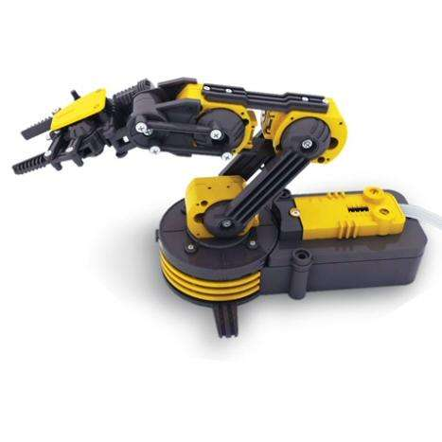
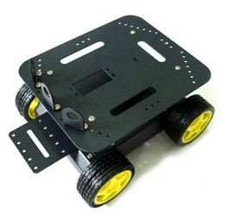
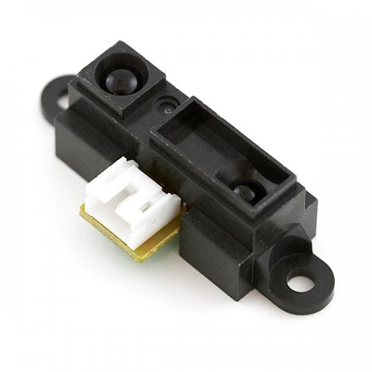
Robot Parts
The IOIO-OTG controller
Three TB6612FNG motor controllers - for the arm
Two DR10002 motor controllers - for the chassis
Owi robotic arm
4WD Mobile Platform – robot chassis
GP2D12 distance sensoer
In addition we added 3 potentiometers to the arm's shoulder, elbow and wrist joints. This enabled us to monitor the joint's position and write functions that move a joint to a certain angle. In control theory this is called a close-loop system.

Slide 7
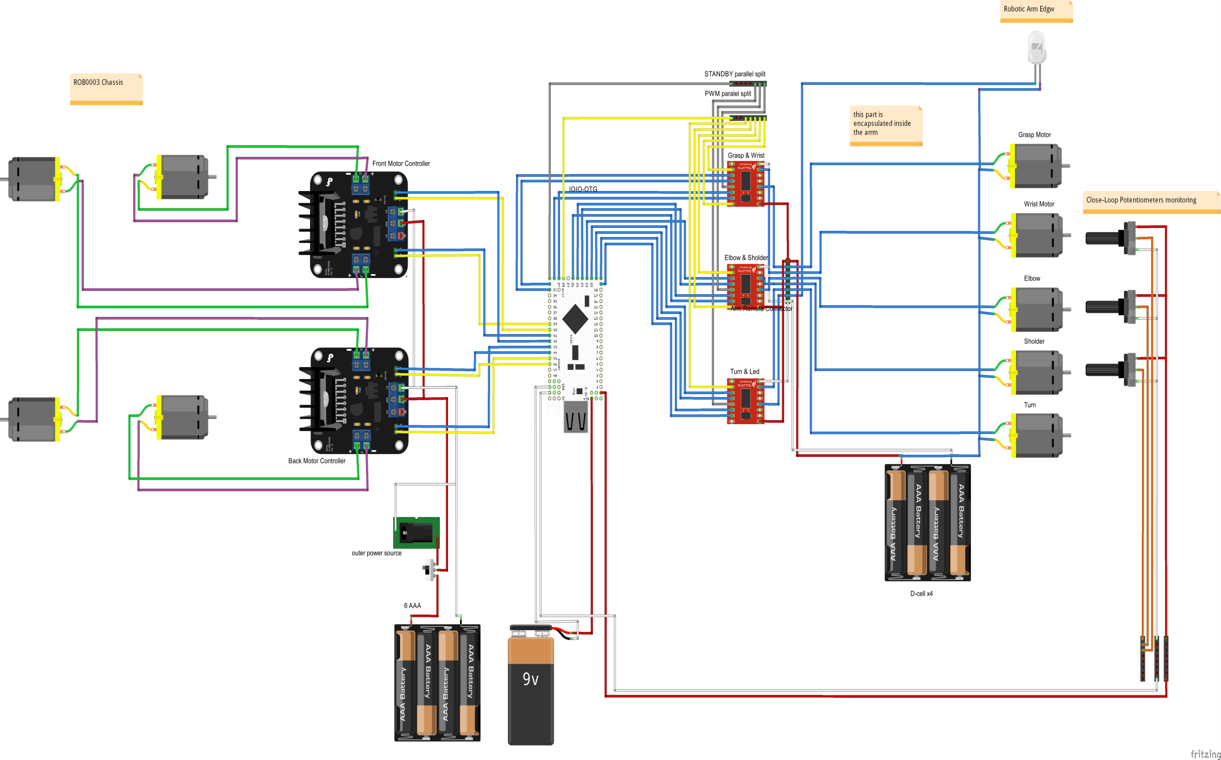
Robot Assembly Sketch

Slide 8
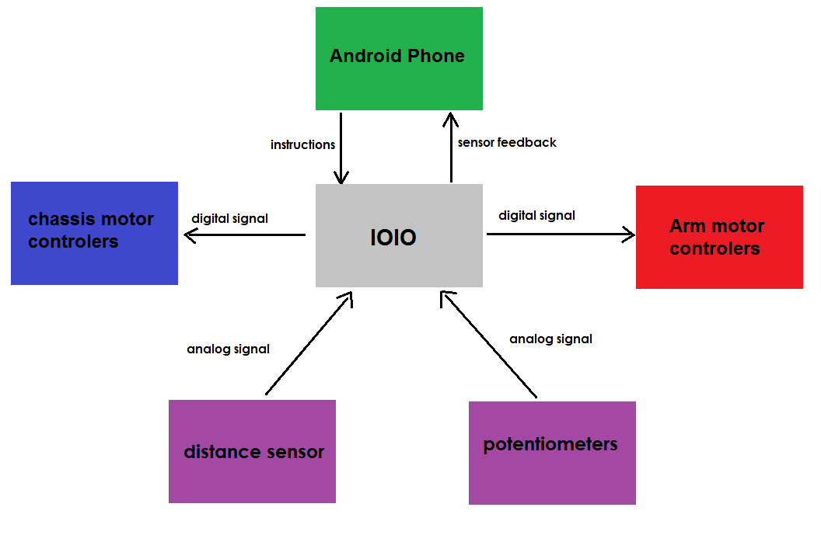
How We Control the Robot (Close-Loop System)

Slide 9
Software

Slide 10
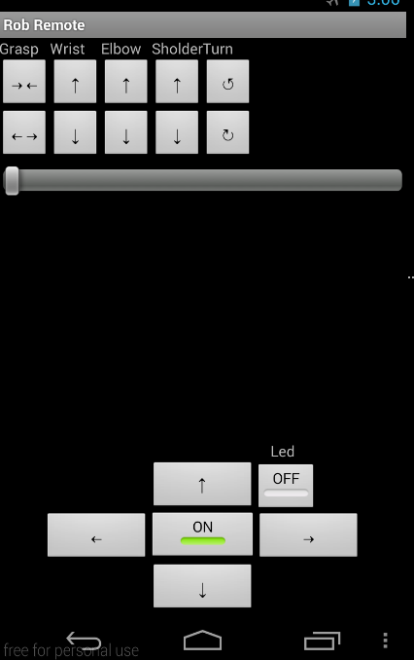
The Remote Control App

Slide 11
The Remote Control App
Writing a basic remote control that controls the robot
In order to do that we had to write all functions that control the robot
Eventually we wrote a movement system class that contains all robot movement functionality

Slide 12
The Main App
An autonomous application.
Movement module.
Vision module.
Main loop - takes info from the camera and sensors, controls the arm and chassis and builds the cube tower.

Slide 13
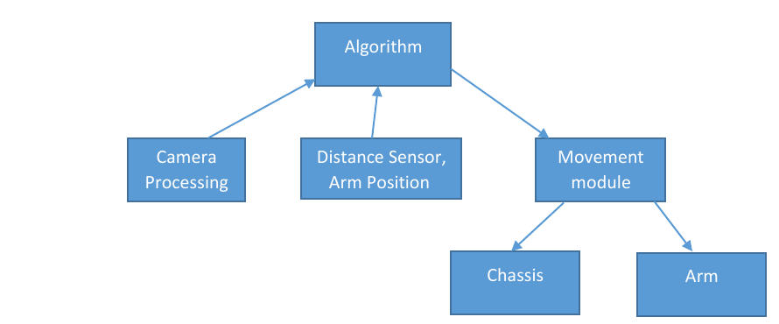
General Architecture

Slide 14
Object Detection
The goal: Identifying individual cubes by color, and extracting their basic properties (horizontal location, distance).
The tools: A single camera, controlled by an Android phone, and OpenCV.
The process: Each camera frame is processed individually and independently. Each frame goes through several processing steps.

Slide 15
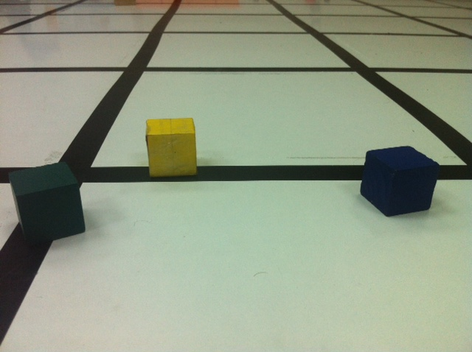
Object Detection - Steps
Example – detecting and separating a blue cube.
We start with a regular RGB (or BGR) image:

Slide 16
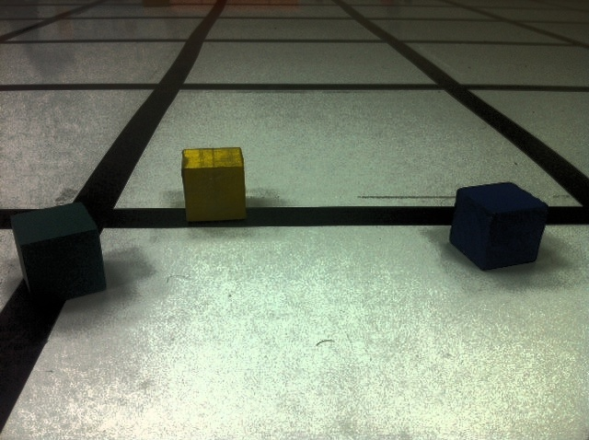
Step 1
Normalize the overall lightness of the image (Convert to HSV then equalize the V channel histogram).

Slide 17
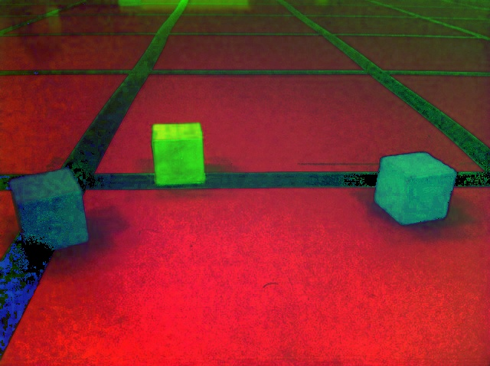
Step 2
Convert to HSV for “easy“ color-separation (in reality part of step 1).

Slide 18
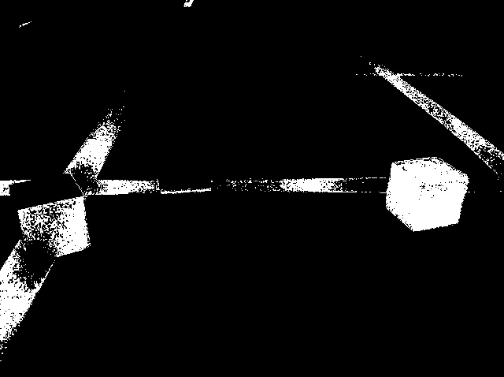
Step 3
Thresholding. Filter out “bad” colors by specifying “good” HSV ranges.
Problem: Noise, sometime hard to separate colors.

Slide 19
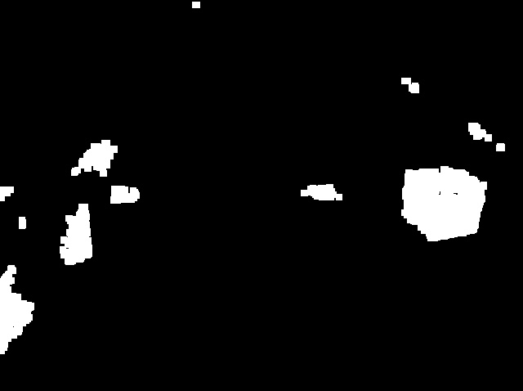
Step 4
Morphological operations – dilate and erode.

Slide 20
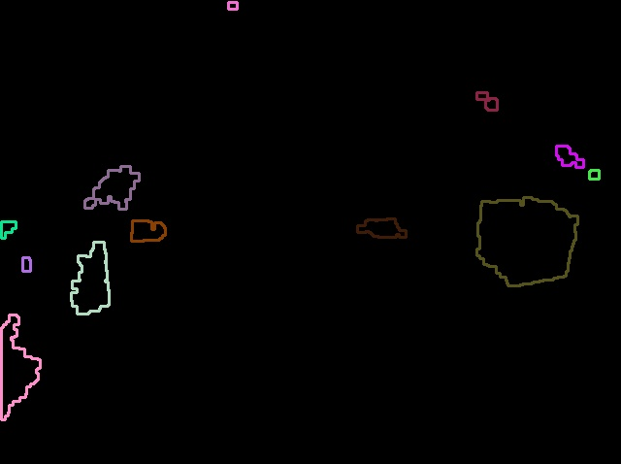
Step 5
Contour detection (external contours only):
Problem: There are too many!

Slide 21
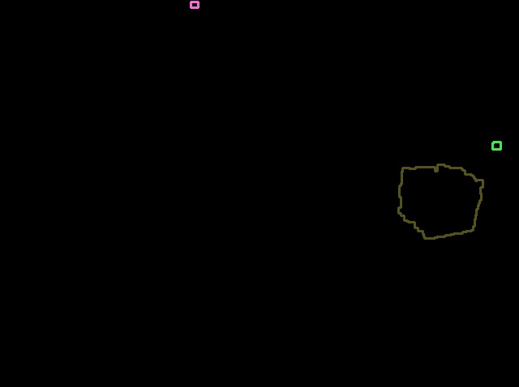
Step 6
Observation: Cubes are special.
Step 6: Filter by contour properties. We use aspect ratio and extent.

Slide 22
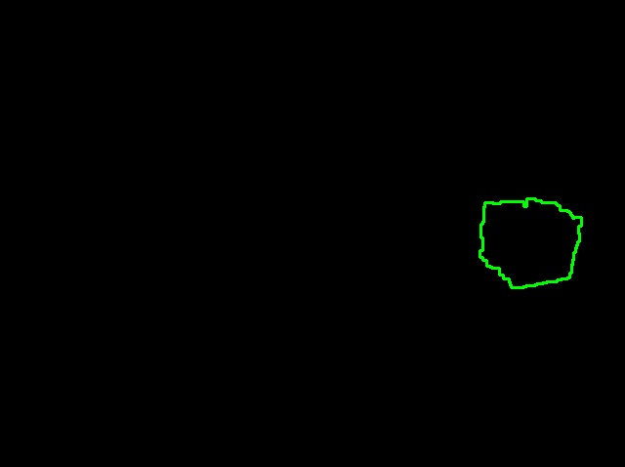
Step 7
Take the contour with the largest area.

Slide 23
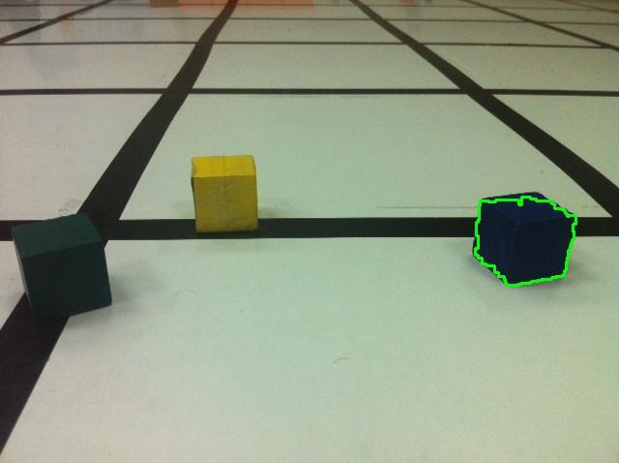
Result

Slide 24
Extract Data
Calculate center location on the X axis.
Distance: Only 1 camera, but we know the cube dimensions in advance, so…
D=FW’/W
W’
F
D
W

Slide 25
The above is done for each frame. The cube details (distance and center location) are then updated in a separate class that is available to any actor.

Slide 26
Main App - Moving the Arm
Moving the arm for the correct angle with the help of the potentiometers.
Releasing and grabbing the cube
Calculating the right position of the arm to grab a cube

Slide 27
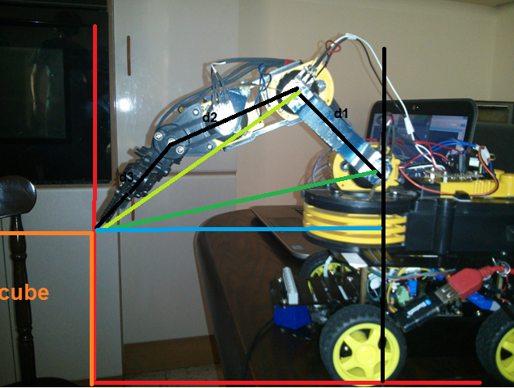
Moving the arm to grabbing position

Slide 28
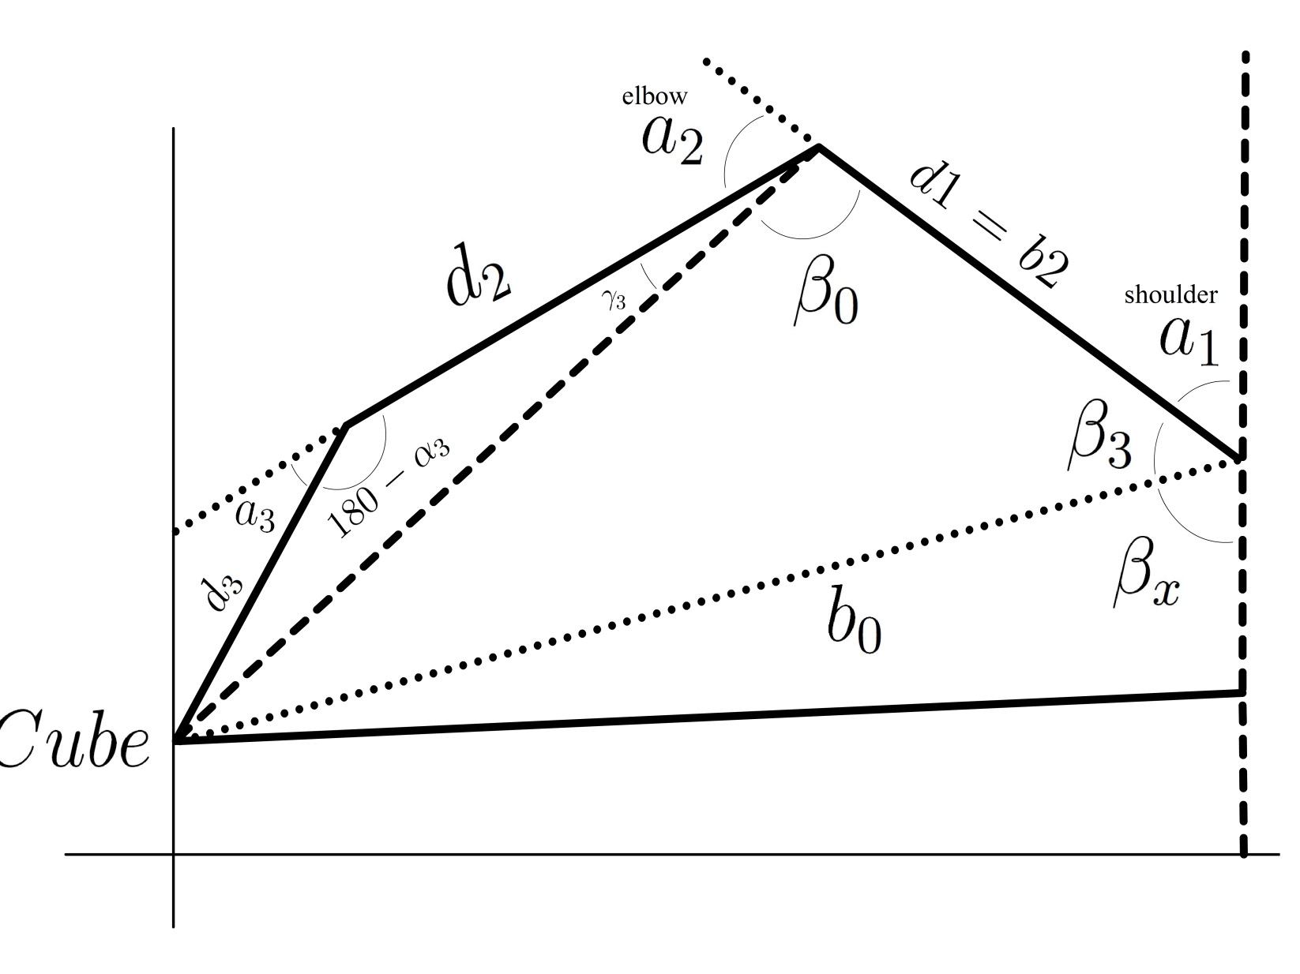
Function for Moving the Arm

Slide 29
Main App - Main Control Loop (Moving Everything Else)
Interfaces with everything:
Reads cube data (location, distance from camera, distance from proximity sensor)
Calls movement module methods for robot control.
Runs in a separate thread.

Slide 30
Main Control Loop
The basic idea:
Look for a certain cube.
Move to the cube.
Take/Put cube.
Change required color & Goto 1.

Slide 31
Main Control Loop - Problems
In reality - things are more complicated:
The robot can’t drive straight. Movement forward needs potentially to be corrected.
Noise might momentarily interfere.
Camera lag.
When robot is too close to the cube – we cannot rely on the camera!

Slide 32
Main Control Loop - Solutions
In practice:
When navigating by camera – can change behaviors in any order (For example: move, stop for reorientation, then move again). Solves direction problems and most noise issues.
For lag – we move slower with “sleep”.

Slide 33
Main Control Loop - Solutions
Cont.
When close: Switch to “Navigate by proximity sensor only” mode. Then move slowly and incrementally until the correct value is reached.
Problem: proximity sensor is sometimes erratic. Solution: Use a moving average instead of individual reads.

Slide 34
Final Words
A bottom-up project.
Main lesson – virtual reality and “real” reality are two very different things.
Project is fully documented with Gitwiki and Javadoc.
The project code is stored on Github as open-source.
https://github.com/doronAtuar/Autonomous-Tower-Builder-Robot

Slide 35
?Questions

